Slide 1
MMA708 - Analytical Finance II EXOTIC CAP PRICING 18 December 2013
Authors: Patrik Konat, Manuel García Narváez
Lecturer: Jan Röman

Slide 2
Content
Introduction ……………………………………………..… 3
Cap and floors …………………………………….……... 4
Pricing caps ……………………………………….……... 10
Exotic barrier caps …………………………….………. 13
Dual strike caps ………………………………………….. 14
Knock-out caps ……………………………………....…. 16
Sticky caps …………………………………………………. 18
Other exotic caps ……………………………………….. 19

Slide 3
Introduction
We are going to show what a cap and a floor are, and how to use Monte Carlo to price a cap.
Then, we will talk about exotic caps, their properties, and how to price two of them using the previous material.

Slide 4
Caps and floors
An interest rate cap (cap for short) is a derivative in which the buyer receives payments at the end of each period in which the interest rate exceeds the agreed strike rate.
Similarly, an interest rate floor (floor for short) is a derivative contract in which the buyer receives payments at the end of each period in which the interest rate is below the agreed strike rate.
A cap or floor can be seen as a portfolio of European Interest rate call options named caplets, or floorlets respectively, which are linearly combined. A cap can therefore be priced by adding the sum price of all individual caplets and floors as the sum of all floorlets.

Slide 5
Caps and floors
They are usually traded over-the-counter (OTC) market. They are designed to provide insurance against the rate of interest on floating-rate notes rising above a certain level.
The parameters for such instruments are commonly:
1) Notional Payment / Face Value, denoted as N.
2) Cash Flow Dates, denoted as $t_{i}.$
3) Floating Strike (Interest rate), denoted as $R_{k}.$
4) Strike Rate (Cap rate), denoted as K.

Slide 6
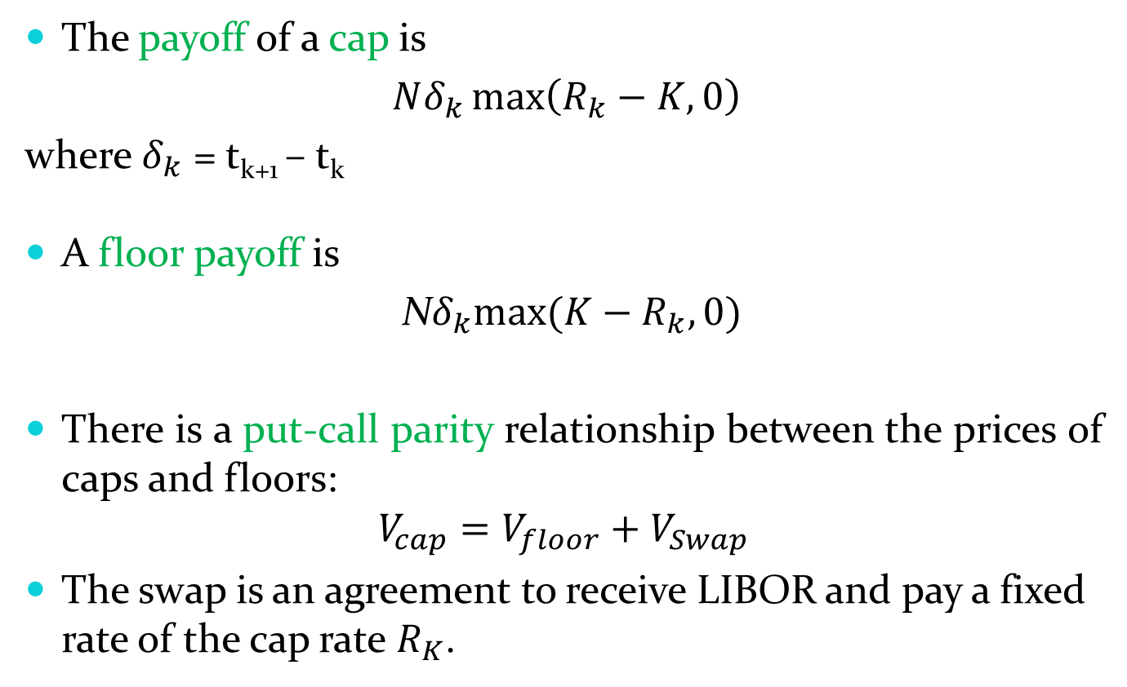
Caps and floors
The payoff of a cap is
$Nδ_{k}\max\left(R_{k}−K, 0\right)$
where $δ_{k}$ = t_{k+1} – t_{k}
A floor payoff is
N$δ_{k}max(K−R_{k}, 0)$
There is a put-call parity relationship between the prices of caps and floors:
$$V_{cap}=V_{floor}+V_{Swap}$$
The swap is an agreement to receive LIBOR and pay a fixed rate of the cap rate $R_{K}$.

Slide 7
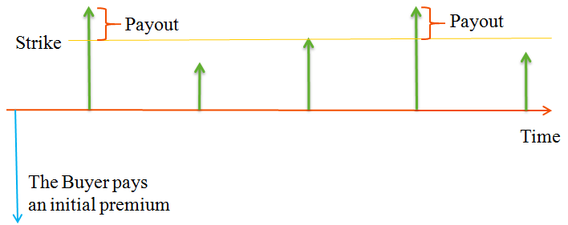
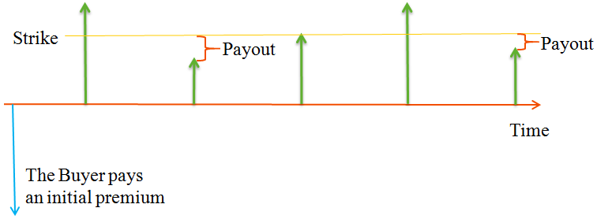
Caps and floors
Cap payoff
Floor payoff

Slide 8
Caps and floors
The value of a cap, denoted c, and floor, f, is
$c=NδP\left(0,t_{k+1}\right)[F_{k}N\left(d_{1}\right)−KN\left(d_{2}\right)$]
f = $NδP\left(0,t_{k+1}\right)[KN\left({−d}_{2}\right)−F_{k}N\left(−d_{1}\right)]$
where
$$d_{1}=\frac{\ln\left(\frac{F_{k}}{K}\right)+σ_{k}^{2}t_{k}/2}{ σ_{k} \sqrt{t_{k}}}$$
$$d_{2}=d_{1}−σ_{k} \sqrt{t_{k}}$$
F_{k} is the forward interest rate at time 0 between t_{k} and t_{k+1}$(δ)$, σ_{k} its volatility, and $P\left(0,t_{k+1}\right)$ is the discount factor.
This formula is derived using Black model.

Slide 9
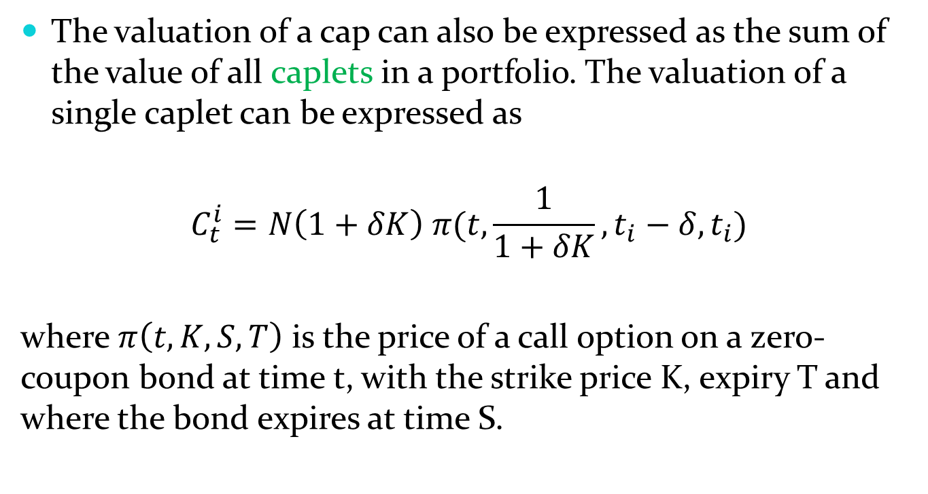
Caps and floors
The valuation of a cap can also be expressed as the sum of the value of all caplets in a portfolio. The valuation of a single caplet can be expressed as
$$C_{t}^{i}=N\left(1+δK\right) π(t,\frac{1}{1+δK},t_{i}−δ,t_{i})$$
where $π\left(t, K,S, T\right)$ is the price of a call option on a zero-coupon bond at time t, with the strike price K, expiry T and where the bond expires at time S.

Slide 10
Pricing caps
Steps:
1) Put initial Libor rates.
2) Simulate Wiener process.
3) Calculate Libor.
4) Calculate caplet and cap prices.
5) Do average (Monte Carlo).

Slide 11
Pricing caps
In order to calculate Libor, we use the discretization of the following SDE that Libor satisfies:
which is
where L_{i}(T_{k+1}) is the forward Libor rate, δ_{i} is t_{i+1} – t_{i}, and W is the Wiener process.

Slide 12
Pricing caps
We have also used that C_{i}(t) / B_{n+1}(t) is martingale under the Terminal measure, where C_{i}(t) is the present value of a caplet at time t, and B_{n+1}(t) is the bond price.
In the calculations, we have supposed that δ and the volatility are constants, in order to make things easier.

Slide 13
Exotic barrier caps
In addition to the plain vanilla caps there are several contracts traded on the international OTC market where the cash flow are similar to a plain vanilla cap, though the contract deviates in one or more aspects.
Therefore, the pricing of a cap will look considerably different depending on what parameters are being changed.
An cap whose payoff depends if the underlying asset has reached a predetermined level or barrier is known as a barrier cap. We are going to focus on dual strike, knock-out and sticky caps.

Slide 14
Dual strike caps
A dual strike cap (N-cap or indexed strike cap) is similar to a cap with a cap rate of K₁ in periods when the underlying floating rate l(t+δ, t) stays below a pre-specified level l, and similar to a cap with a cap rate of K₂, where K₂ > K₁, in periods when the floating rate is above l.
Hence the Dual strike cap work as one out of two different caps depending on whether or not the trigger has been activated. Due to the change in its strike rate, dual strike caps are cheaper than ordinary caps.

Slide 15
Dual strike caps
For this reason, an investor would like to purchase a dual strike cap in order to get a cheaper cap, but getting a lower premium if the Libor rate is high. An investor would like to sell it because he will be protected against higher Libor, but, on the other hand, the price will be lower than if he would sell a standard cap.
Example: If an investor buys an N-cap with first strike rate equal to 5%, trigger at 10% and second strike rate at 14%. If Libor is lower than 5% in a payment date, then the payoff is zero. If Libor is between 5% and 10%, the payoff is Libor-5, since the strike rate will be 5%. If Libor is between 10% and 14%, the payoff is zero, since now the strike rate is 14% (in a standard cap, the payoff would be Libor-5). Finally, if Libor is greater than 14%, the payoff is Libor-14 (in a standard cap, the payoff would be Libor-5).

Slide 16
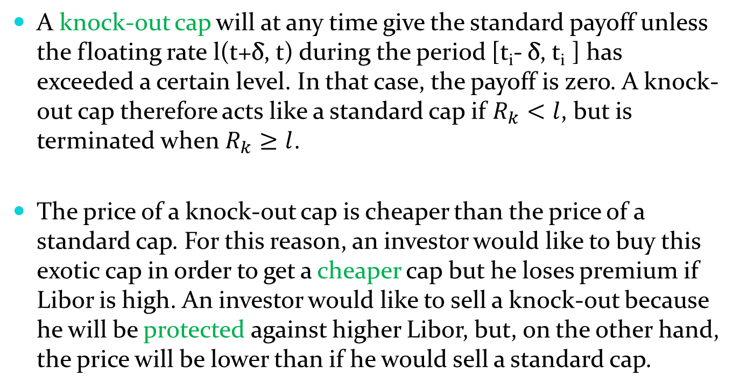
Knock-Out caps
A knock-out cap will at any time give the standard payoff unless the floating rate l(t+δ, t) during the period [t_{i}- δ, t_{i} ] has exceeded a certain level. In that case, the payoff is zero. A knock-out cap therefore acts like a standard cap if $R_{k}<l$, but is terminated when$R_{k}≥l$.
The price of a knock-out cap is cheaper than the price of a standard cap. For this reason, an investor would like to buy this exotic cap in order to get a cheaper cap but he loses premium if Libor is high. An investor would like to sell a knock-out because he will be protected against higher Libor, but, on the other hand, the price will be lower than if he would sell a standard cap.

Slide 17
Knock-out caps
Example: An investor is very profitable if the Libor is greater than 15%. The rate is currently at 8%. To protect himself the investor purchases a knock-out cap, with trigger equal 15%. It is cheaper than buy a standard cap, and if the Libor is greater than 15%, he does not get payments from the cap, but still manages to be in the money.

Slide 18
Sticky caps
A sticky cap is like a standard cap, the only difference is its strike rate, which is given by K₁ = min [K, m] and K_{i} = min [min {K_{i-1}, L_{i-1}} + X, m], for i>1, where X is the spread, and m is some level.
For instance, if we have s sticky cap with spread equal to 2%, level equal 10%, if the previous strike rate was 5%, and the previous Libor was 6%, then the today’s strike rate is min[ min {5, 6} + 2, 10] = min [7, 10] = 7%.
Each payment in the sticky cap depends on all previous payments. Then, the cap is said to be path-dependent.

Slide 19
Other exotic caps
Bounded cap: it is like a standard cap, but when the sum of payments received so far is greater than some specified level, then the payoff will be zero.
Ratchet cap: it is like a standard cap, the only difference is its strike rate, which is given by K₁ = min [K, m] and K_{i} = min [K_{i-1} + X, m], for i>1, where X is the spread, and m is some level.
Flexi cap (or auto cap): it is like a standard cap, but only the first n in-the-money caplets are exercised (n is lower than the number of cash flows).
Chooser cap: it is a flexi cap where the holder can choose the caplets to exercise.

