Slide 1
Nelson-Siegel-Svensson model: application for Swedish government bonds
MMA 708 - Analytical Finance II
Teacher: Jan Roman
He Bo
Ashot Khalatyan
Omogunloye Oluwasanmi

Slide 2
Introduction
We attempt to calculate term structure of Swedish government bonds using Nelson-Siegel-Svensson model.
Excel/VBA was used to minimize squared difference between actual bond price and model price calculated with Nelson-Siegel-Svensson model.

Slide 3
Nelson-Siegel model for the forward curve:
Where, $β_{1}{,β}_{2},β_{3 }$are parameters which are constant to be estimated, and $Ʈ_{1}$is also constant. Integrating the equation (1) above, we get
If we change the variables:

Slide 4
We get:
This implies the following spot rate formula:
Where are constants to be estimated

Slide 5
Nelson-Siegel model Extension
Nelson-Siegel model was extended by Svensson (1994):
Deducting the basic Nelson-Siegel model, we get
Where are constants to be
estimated.

Slide 6
Application in Excel/VBA
With the theory above we collected data from nasdaqomxnordic.com and used Excel Solver and VBA to get the term structure.
VBA codes “P_nse” and “R_nse” where created to calculate bond price and rate using Nelson-Siegel-Svensson model

Slide 7
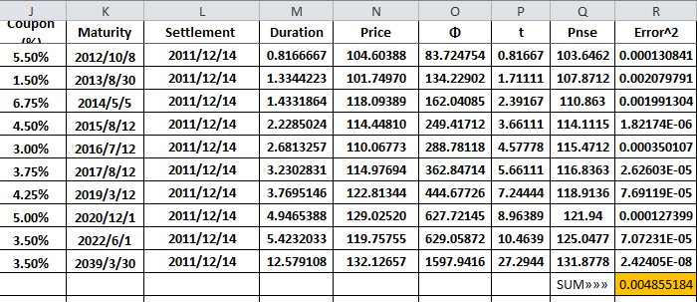
Excel calculations

Slide 8
