Slide 1
Bermudan Options
with the
Binomial Model

Slide 2
Who are we?
Amir Kazempour
Iran
Hossein Nohrouzian
Iran
Jessica Radeschnig
Sweden
Analytical Finance

Slide 3
Agenda
The Binomial Model
Pricing Different Options
Example
MATLAB Implementation
Questions

Slide 4
The Binomial Model
The Expected Value of the Underlying
$$S_{0}u$$
𝑆_0 𝑢
$$S_{0}uu$$
𝑆_0 𝑢𝑢
$$S_{0}ud$$
𝑆_0 𝑢𝑑
$$S_{0}d$$
𝑆_0 𝑑
$$S_{0}dd$$
𝑆_0 𝑑𝑑
$$S_{0}$$
𝑆_0
$${p^{∗}}^{2}$$
$$p^{∗}$$
$$p^{∗}(1−p^{∗})$$
$$\left(1−p^{∗}\right)p^{∗}$$
$$(1−p^{∗})$$
$${\left(1−p^{∗}\right)}^{2}$$

Slide 5
The Binomial Model
The Up and Down Factors
$$u=e^{σ\sqrt{∆T}}$$
$$d=e^{−σ\sqrt{∆T}}$$

Slide 6
The Binomial Model
The Risk-Neutral Probability Measure
$$p^{∗}=\frac{e^{r∆T}−d}{u−d}$$

Slide 7
Pricing Different Options
Pay-off Functions
 | Position
Option Type | Long | Short
Call | max(S_{T} -K,0) | -max ( S_{T} -K,0 )
Put | max(K-S_{T} ,0) | -max(K-S_{T} ,0)

Slide 8
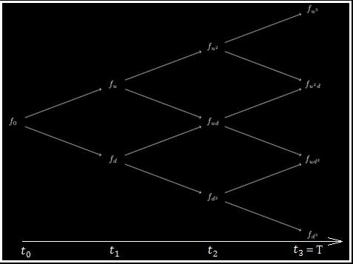
Pricing Different Options
$$\begin{aligned}f_{T}=Long Pay−Off \\ f_{t}=e^{−r∆T}p^{∗}f_{u}\left(t+1\right)+\left(1−p^{∗}\right)f_{d}\left(t+1\right)\end{aligned}$$
$$for t=T$$
$$for 0≤t≤\text{T}$$
European
American
Bermudan

Slide 9
Example
S₀ =$40
K=$42
r=12%
∆T=3-month
T=9 months
u=1.1
d=0.9
European Put Option

Slide 10
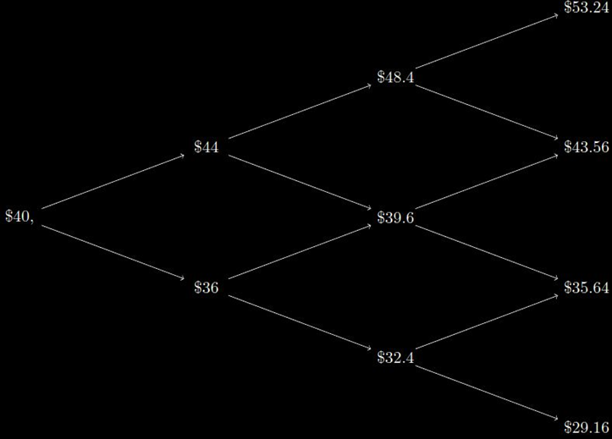
Value of the underlying
Example

Slide 11
Example
Calculating the Risk-Neutral Probability:
$$p^{∗}=\frac{e^{r∆T}−d}{u−d}$$
$$p^{∗}=\frac{e^{0.12\left(\frac{3}{12}\right)}−0.9 }{1.1−0.9}≈0.6523$$

Slide 12
Price of the European Option
Example
$$P_{E}=e^{r∆T}\left[{p^{∗}}^{3}f_{u^{3}}+3{p^{∗}}^{2}\left(1−p^{∗}\right)f_{{du}^{2 }}^{}+3p^{∗}{\left(1−p^{∗}\right)}^{2}f_{ud^{2}}+{\left(1−p\right)}^{3}f_{d^{3}}\right]=\$1.8687$$
0
0
0.7242
0
1.8687
2.1462
6.36
4.1792
8.3587
12.84

Slide 13
Price of the American Option
Example
max{42-53.24,0}
0
max{42-43.56,0}
max{42-35.64,0}
0
max{42-29.16,0}
0.8099
0
max{0,0}
max{2.4,2.1462}
max{9.6,8.3587}
2.5374
2.4
max{0,0.8099}
max{6,4.7587}
6
6.36
9.6
12.84
$$P_{A}=e^{−r∆T}[p^{∗}\left(0.8099\right)+6\left(1−p^{∗}\right)]=2.5374$$

Slide 14
Price of the Bermudan Option
Example
max{42-53.24,0}
0
max{42-43.56,0}
max{42-35.64,0}
0
max{42-29.16,0}
0.7242
0
2.4831
2.1462
max{0,0.7242}
max{6,4.1792}
6
6.36
8.3587
12.84
$$P_{B}=e^{−r∆T}[p^{∗}\left(0.7242\right)+6\left(1−p^{∗}\right)=2.4831]$$

Slide 15
Comparing the Results:
Example
$$1.8687≤2.4831≤2.5374$$
$$European Price≤Bermudan Price≤American Price$$

Slide 16
MATLAB Implementation
Calculate the fair price
European Option
Bermudan Option
American Option
Binomial Option Pricing Model(BOPM)
Numerical Method
Discrete Time
Proposed first by:
- JC Cox, SA Ross, M Rubinstein - Journal of financial Economics, 1979 (Option Pricing: A simplified approach)

Slide 17
binCalculator Function
MATLAB Implementation
function [euPrice, amPrice, brPrice] = binCalculator(S,K,r,sigma,T,N,exercise_Frequency,put_True)
S: Spot price, e.g., 50.
K: Strike pricem, e.g., 50.
r: Risk-free interest rate e.g., 0.1 for 10%.
sigma: Volatility, e.g., 0.3 for 30%.
T: Years to maturity, e.g., 1 for 1 year.
N: Number of steps in the binomial tree.
Exercise Frequency: Number of times that the Bermudan option can be exercised in a year, e.g., 12 for the monthly exercise.
put_True: 1 for put option, 0 for a call.

Slide 18
Graphical User Interface
MATLAB Implementation
It reads the binCalculator input parameters from the textboxes.
User will choose between Put Option and Call Option.
Shows the prices calculated by the model.

Slide 19
Graphical User Interface
MATLAB Implementation

Slide 20
MATLAB Codes
MATLAB Implementation
Create the binomial tree, using the up and down factor.
Create the exercise_True vector: It indicates if the Bermudan can be exercised at a certain node.
Depending on the value of the put_True, the pay off tree, binTreeEE, is created.
- Pay-off at each node if the option is exercised at that node.

Slide 21
MATLAB Implementation
binTreeNE
European option’s binomial tree.
Value of each node is equal to the expected pay-off of the two successive nodes, under the risk neutral probability.
binTreeAm
American option’s binomial tree.
Each node is the greater of the
binTreeEE value
and
Expected pay-off of the two successive nodes.
MATLAB Codes

Slide 22
MATLAB Implementation
binTreeBr
Bermudan option’s binomial tree
If the exercise_True at the node is not zero, then, the pay-off is calculated as the one in American option.
If the exercise_True at the node is zero, the pay-off is calculated as the one in the European option.
MATLAB Codes

Slide 23
MATLAB Implementation
Running the code in MATLAB
Checking the binomial trees created by the application.
Running the GUI
Calculating the options’ fair prices for different values of exercise frequency
MATLAB Codes

Slide 24
Questions?

Slide 25
Thank You!

