Slide 1
Analytic Financial “Asset-or-nothing digitals”
Mahamadi Ouoba
Amina El Gaabiry
David Johansson

Slide 2
Definition of Asset-or-Nothing:
An exotic option
Binary
The Asset-or-Nothing Call option
The Asset-or-Nothing Put option

Slide 3
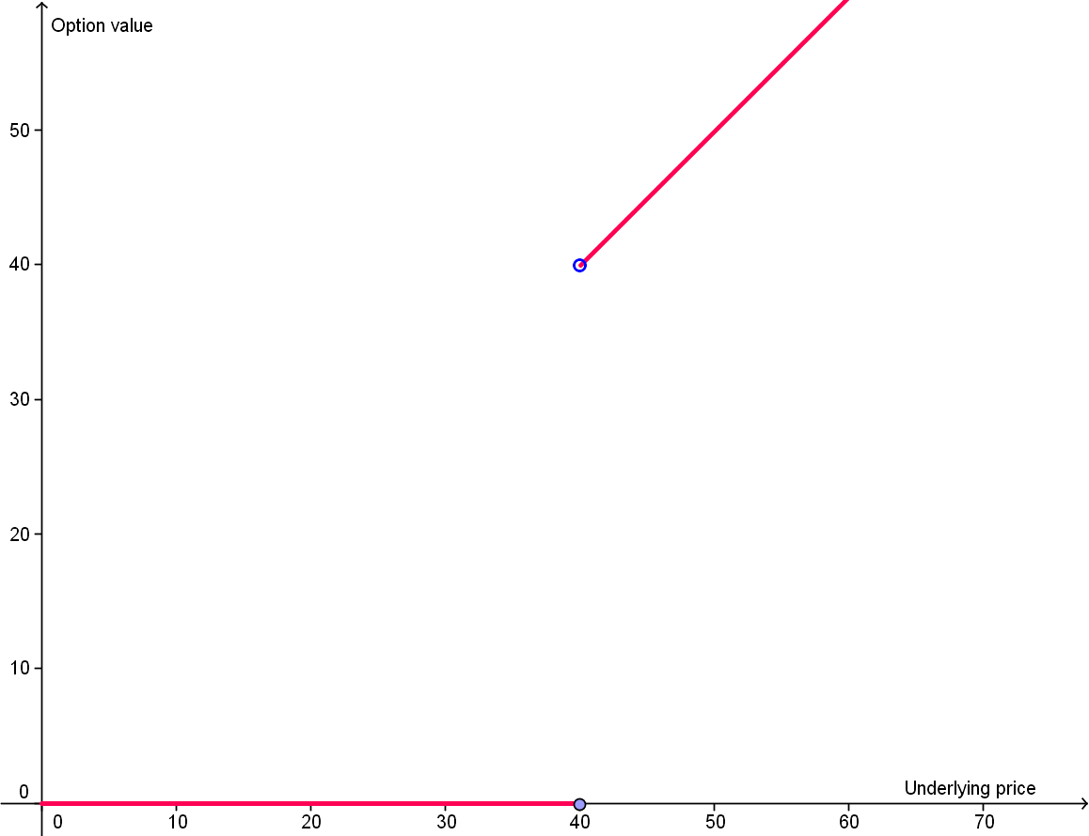
Payoff graphs:
Figure 1 Payoff of binary asset-or-nothing call option with strike price 40 .

Slide 4
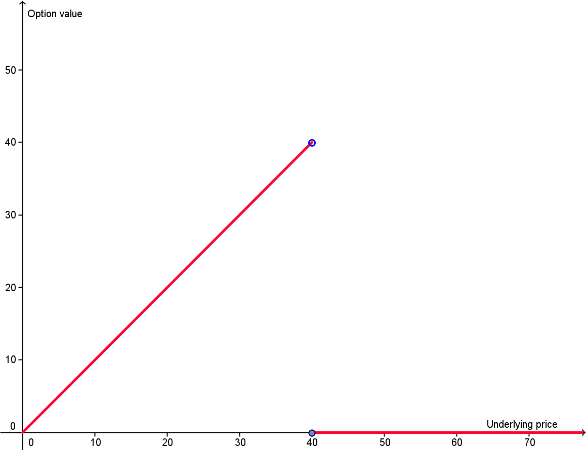
Figure 2 Payoff of binary asset-or-nothing put option with strike price 40.

Slide 5
The price of a binary asset-or-nothing :
Call option :
$$\prod_{t}{\left[BAC_{t}\right]=SN\left(d\right)}$$
Put option:
$$\prod_{t}{\left[BAP_{t}\right]=SN(−d)}$$

Slide 6
The Greeks
Definition of Greeks
The PDE of d :
$$d= \frac{1}{σ\sqrt{T−t}}\left\{\ln\left\{\frac{S}{K}\right\}+\left(r+\frac{1}{2}σ^{2}\right)\left(T−t\right)\right\}$$

Slide 7
Delta (∆)
Call option:
$∆_{call}$=$N\left(d\right)+\frac{1}{σ\sqrt{T−t}}N^{′}(d)$
Put option:
$$∆_{put}=N\left(−d\right)−\frac{1}{σ\sqrt{T−t}}N^{′}(−d)$$

Slide 8
Gamma (Γ)
Call/Put option:
$$Γ_{put}=Γ_{call}=\frac{N^{′}\left(d\right)}{σS\sqrt{T−t}}\left[1−\frac{d}{σ\sqrt{T−t}}\right]$$

Slide 9
Rho (ρ)
Call option:
$ρ_{call}$=$S \frac{\sqrt{T−t}}{σ}$ $N^{′}(d)$
Put option:
$ρ_{put}$ $=−S\frac{\sqrt{T−t}}{σ}N′(−d)$

Slide 10
Vega (ϒ)
Call option:
$Ƴ_{call}$ $=S(\sqrt{T−t}−σd)N^{′}(d)$
Put option:
$Ƴ_{put}$ $=−S\left(\sqrt{T−t}−σd\right)N^{′}\left(−d\right)$

Slide 11
Theta (Θ)
Call option:
$Θ_{call}$ $=SN^{′}\left(d\right)\frac{d}{2\left(T−t\right)}−\frac{\left(r+\frac{1}{2}σ^{2}\right)}{σ\sqrt{T−t}}$
Put option:
$Θ_{put}$ $=−S\frac{d}{2\left(T−t\right)}−\frac{\left(r+\frac{1}{2}σ^{2}\right)}{σ\sqrt{T−t}}N′(−d)$

Slide 12
Numerical derivatives
$∆=\frac{C\left(t,S+δ, σ,r,K\right)−C\left(t,S−δ,σ,r,K\right)}{2δ}$
$Γ=\frac{C\left(t,S+δ, σ,r,K\right)−2C\left(t,S,σ,r,K\right)+C(t,S−δ,σ,r,K)}{δ^{2}}$
$ρ=\frac{C\left(t,S,σ,r+δ,K\right)−C\left(t,S,σ,r−δ,K\right)}{2δ}$
$Ƴ=\frac{C\left(t,S, σ+δ,r,K\right)−2C\left(t,S,σ−δ,r,K\right)}{2δ}$
$Θ=\frac{C\left(t+δ, S,σ,r,K\right)−C\left(t,S,σ,r,K\right)}{δ}$

