Slide 1
Problem With Volatility
MMA 707 Analytical Finance I
Lecturer: Jan Röman
Members：
Bo He
Xinyan Lin

Slide 2
Introduction
In finance, volatility is a measure for variation of price of a financial instrument over time. It is a general measure for traders analyze how risky he has been exposed by holding his financial instruments. Unfortunately, the volatility does not concern the direction of the price changes.

Slide 3
Implied volatility
The implied volatility of an asset is an estimate of volatility, or rate of price change, for the asset. It is the volatility of the option implied by current market prices. In mathematical finance, volatility is defined as the annualized standard deviation of daily price changes. Implied volatility can be interpreted as the market expected future volatility.

Slide 4
Calculate Implied Volatility with Black-Sholes Model:
$C_{BC}$ ------ price of the call
$C_{market }$------ ption price from the market

Slide 5
In order to find the root in the model, we can apply the Newton-Raphson Method as follow:
So start with ${\text{σ}}_{0}$ by guessing a initial value:
eventually as soon as the following equation holds, our implied volatility is estimated.
p* is the observed price of put

Slide 6
The same method apply to call option:

Slide 7
Historical Volatility
The historical volatility is basically the volatility of a financial instrument over a given time period

Slide 8
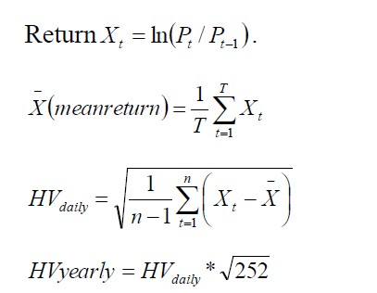
Calculation of Historical Volatility
T: period of the observation.
P: the price in day t
t : from 1 to T+1

Slide 9
Implied Volatility and Historical Volatility
Historical volatility reflects the price movement of the underlying asset during a past period, that is to say, it looks backward at price actions and measures the degree of change in the price of a security. While the implied volatility it looks forward.

Slide 10
Application

Slide 11
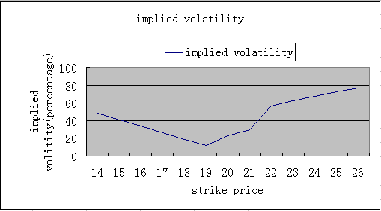
Result
ABB Call option:

Slide 12
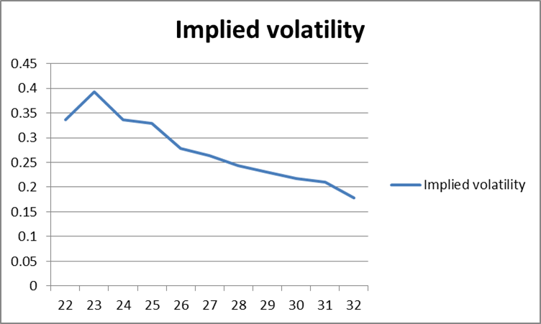
Microsoft Call option

Slide 13
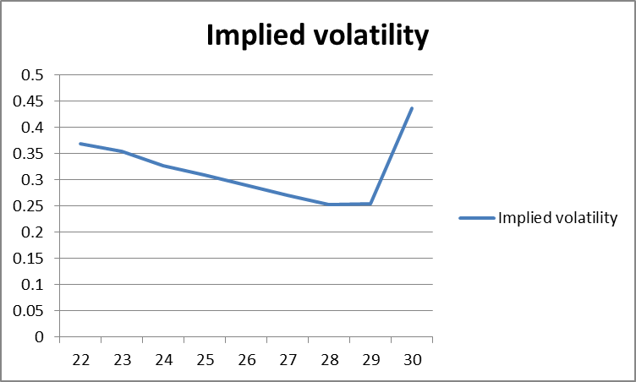
Microsoft Put option

Slide 14
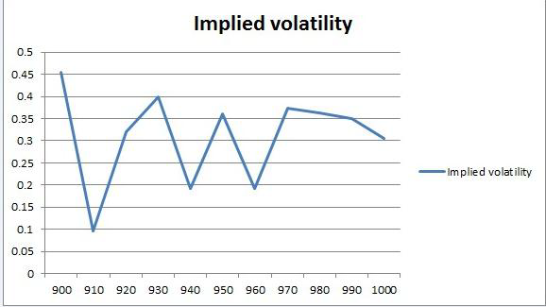
Index call and put options OMXS30

Slide 15
Thank you !

