Slide 1
Funding Interest Rate Derivative Collateral in the Banking Book
Stephen Temple
September 2013
London

Slide 2
Agenda
What is Banking Book interest rate risk and how is it managed
Specific challenges when compared with the trading book view
Implications for funding the derivative MTM
Considering the appropriate funding duration
Governance
The role of a central treasury function and customer pricing
Conclusion

Slide 3
Banking Book Risk Management Banking book P&L is accrual accounted. Treasury plays a central clearinghouse role for the risk and accounting volatility.
Banking Book Interest Rate Risk Hedging Structure
Key Points:
Bifurcation in Banking Books between fixed rate cash and interest rate derivative hedging.
Fixed rate products require derivative hedging with external markets
No ability to collateralise banking book interest rate risk volatility vs. customers but requirement still exists to collateralise vs. street
Business originating assets do not have the level of sophistication/expertise to manage ongoing derivative collateral requirements
NIM stability is one of the primary objectives of the Banking Book – funding derivative collateral requirements has the ability to destabilise over time if not managed appropriately.
Customer Fixed Rate Savings
Cash
Business
Float
Treasury
Float
Street
Fixed
Fixed
Fixed
Product P&L is accrual accounted
Swap between business and Treasury is accrual accounted and no collateral is posted
Swap between Treasury and Street is marked-to-market with collateral posted daily based on current MtM
P&L Profile
P&L Profile

Slide 4
Banking Book Risk Management vs. Trading Book Funding costs associated with derivative MTM position in Banking Book are trapped within the business/Treasury due to the inability to collateralise on the cash product
Trading Book Structure
Banking Book Structure
Ability to optimise collateral
but no outright position
Wholesale
Market
Net Trading Book
Balance Sheet
Funding/P&L Remittance
MTM profit remitted as cash
Collateral
Clearing House
Collateral
Change in net equity position
Customer Cash Transaction
Un-collateralised accruals
Banking Book
Balance Sheet
Funding/P&L Remittance
Profit remitted on an accrual basis
Un-collateralised accruals
Wholesale
Market
Clearing House
Treasury
Hedge Accounting Solution
Deriv MTM Collateral
Deriv MTM Collateral
Treasury funding Position

Slide 5
Implications for funding
Determining funding requirement
Liquidity constraints require that the derivative collateral position is funded at the appropriate duration.
Multifactor model for determining duration but fundamental principle is that the duration funding should be aligned with expected behavioural life of the derivative MTM position, adjusted for uncertainty to maximise shareholder value.
Banking book product balances are funded based on modelled behavioural lives
Stable funding spreads drive predictable Net Interest Margins (NIM)
Derivative collateral to be funded in a manner which aligns with overall NIM stability objective
Derivative funding requirements to feed into the overall funding plan and transfer pricing framework
Should one of the considerations in the duration determinant be structuring the derivative funding position in a way that foregoes some economic upside for the sake of revenue stability?

Slide 6
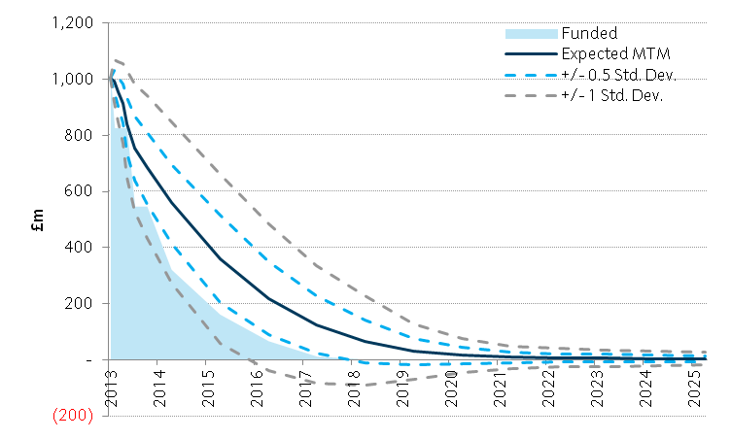
Modelling the Funding Profile for the Open Derivative Position Derivative position funding based on stochastic analysis to determine optimal duration
Methodology
Collateral requirement is driven by market rate volatility over time.
Market movements can be forecast by using stochastic analysis based on embedded market expectations
These movements can be used to value the derivative portfolio at any future point in time, allowing for the generation of an expected marked-to-market run-off profile.
This run-off is the best estimate of the behaviouralised expected collateral funding position over time
Standard deviation bands are used to construct a corridor around the expected (mean) collateral run-off profile.

Slide 7
What is the appropriate funding duration given modelled MTM volatility? Changes in MTM volatility over time requires a subjective overlay to reduce transaction and re-balancing costs
Funding to maturity for variable MTM contracts doesn’t lock in funding cost for the bank
The range of possible funding costs depends on:
Variability of contract MTM’s in prior years
AND
Variability of funding spreads in prior years
Expected Cost
Expected MTM x Expected Spread
Probability
Actual Cost:
Actual MTM x
Actual spread on rebalancing
Net cost of bid-ask
Actual Cost
P&L uncertainty from shareholder perspective
Reducing funding uncertainty by over-funding for the entire life of the portfolio and all reasonable interest rate expectations is uneconomic
The P&L uncertainty from rebalancing long dated funding can be larger than from rebalancing shorter dated funding (particularly true where funding spread and rates move together and then revert, and where long dated funding spreads are larger than short dated)
Any bid ask on funding will always systematically increase funding costs – effect increases for longer dated trades
A strategy which shortens the term funding can be equally or more effective in reducing shareholder P&L uncertainty while reducing the friction costs (at the cost of liquidity risk)
Also, a strategy which shortens the term funding reduces exposure to regulatory and market driven changes in the future

Slide 8
Governing the Funding Position Framework required which is flexible yet consistent across the organisation
Any modelling of an expected rates outcome will prove ineffective over time
Funding need driven by market or other external factors which cannot be controlled in short term
Governance structure required to ensure funding is managed in a manner which does not erode shareholder value but which also represents the true worth of funds.
Limit required to ensure overall funding framework is complied with. Framework based on a tenor bucket approach. Allows for flexibility to determine, within agreed boundaries, the optimal funding profile
Use of advisory trigger limits and breach frequencies.

Slide 9
Customer Pricing and the Role of Treasury Treasury has the ability to pay a more or less active role in the management of the risk associated with derivative MTM funding – largely driven by needs for transparency and revenue stability
As a central point for all business units, Treasury has visibility of the bank’s consolidated CSA / Non-CSA position and is well placed to manage the exposure for the wider banking book
Good natural internal offset of derivative hedges pre externalisation
Two models for managing CSA vs. non CSA risk:
Internal Valuation Model | Description | Advantages | Disadvantages
CSA aware | Internal swap pricing on a CSA basis to reflect the market facing exposure and recharge of the costs associated with management of the net CSA funding requirement by Treasury | Allows Treasury to optimise funding requirement across the balance sheet Full re-allocation of optimised P&L to business lines | Businesses run the risk of funding volatility and associated impacts on NIM Treasury may not optimise resulting in an increased economic cost
Use of Internal Funding Curve for Discounting | Swap pricing at an internal transfer price which reflects true internal funding costs associated with the future cashflows on the derivative position | Funding costs understood upfront by business Absolute certainty of NIM stability – no “nasty surprises” | No benefit to business from optimised position Lack of pricing transparency vs. external sources Volatility within Treasury P&L

Slide 10
Conclusion Funding derivative collateral positions is a reality for the banking book. The appropriate outcome for the business will be driven by the risk management framework and governance adopted
Cost of funding derivative MTM positions is a fact of life for the Banking Book
Banks need to ensure that the true cost of interest rate hedging is priced into their product offering
Overriding objective is Net Interest Margin stability
Tension between revenue stability and a funding profile which delivers value
Appropriate governance structures and transparency around funding are fundamental
Treasury has a role to play - no one size fits all solution

